Slide 3
OUTLINE
Functions of the Financial System
Financial Assets
Financial Markets
Financial Market Returns
Financial Intermediaries
Regulatory Infrastructure

Slide 4
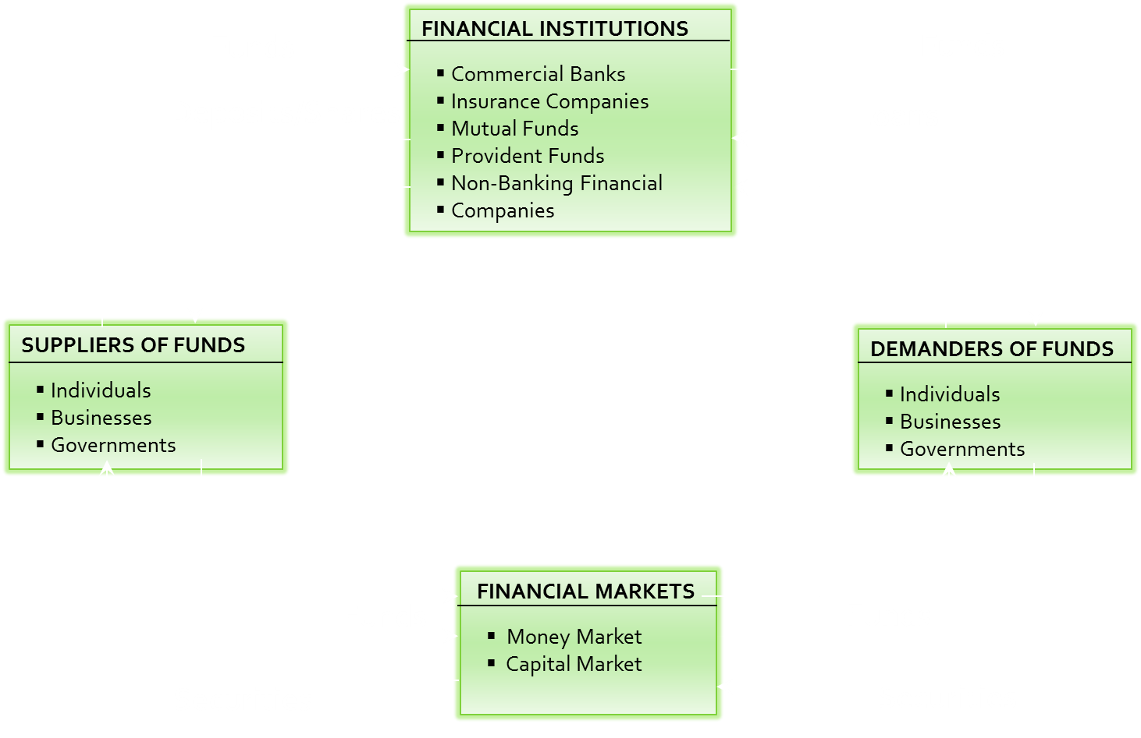
THE FINANCIAL SYSTEM

Slide 5
FUNCTIONS OF THE FINANCIAL SYSTEM
Payment System
Pooling of Funds
Transfer of Resources
Risk Management
Price Information for Decentralised Decision Making
Dealing with Incentive Problem

Slide 6
FUNCTIONS OF THE FINANCIAL SYSTEM
Contd…
Payment System
Depository financial intermediaries such as banks are the pivot of the payment system. Credit card companies play a supplementary role.
Pooling of Funds
Financial markets and intermediaries facilitate the pooling of the household savings for financing business.
Transfer of Resources
The financial system facilitates the efficient life-cycle allocations of household consumption, the efficient allocation of physical capital to its most productive use, and the efficient separation of ownership from management.

Slide 7
FUNCTIONS OF THE FINANCIAL SYSTEM
Contd…
Risk Management
A well-developed financial system offers a variety of instruments that enable economic agents to pool, price, and exchange risk. The three basic methods of managing risk are : hedging, diversification, and insurance
Price Information for Decentralised Decision Making
Interest rates and security prices are used by households in their consumption-saving-investment decisions and by firms in their investment and financing decisions

Slide 8
FUNCTIONS OF THE FINANCIAL SYSTEM
Contd…
Dealing with Incentive Problems
Information asymmetry leads to moral hazard and adverse selection, which are broadly referred to as agency problems.
Financial intermediaries like banks and venture capital organizations can solve the problem of informational asymmetry by handling sensitive information discreetly and developing a reputation for profitable activity

Slide 9
FINANCIAL ASSETS
Financial assets are intangible assets that represent claims to future cash flows. The terms financial asset, instrument, or security are used interchangeably.
Examples :
A 10-year bond issued by the GOI carrying an interest rate of 7 percent.
Equity shares issued by TCS to the general investing public through an initial public offering.
Call options granted by WIPRO to its employees.

Slide 10
FINANCIAL MARKETS
A financial market is a market for creation and exchange of financial assets.
Financial markets play a very pivotal role in allocating resources in the economy by performing three important functions as they:
Facilitate price discovery
Provide liquidity
Reduce the cost of transacting

Slide 11
FUNCTIONS OF FINANCIAL MARKETS
FACILITATE PRICE DISCOVERY
The continual interaction among numerous buyers and sellers who participate in financial markets helps in establishing the prices of financial assets
PROVIDE LIQUIDITY
Thanks to the liquidity provided by financial markets, it is possible for companies (and other entities) to raise long-term funds from investors with short-term horizons
REDUCE THE COSTS OF TRANSACTING
Financial markets considerably reduce the following costs of transacting
Search cost
Information cost

Slide 12

CLASSIFICATION OF FINANCIAL MARKETS
DEBT MARKET
NATURE OF CLAIM
EQUITY MARKET
MONEY MARKET
MATURITY OF CLAIM
CAPITAL MARKET
PRIMARY MARKET
SEASONING OF CLAIM
SECONDARY MARKET
CASH OR SPOT MARKET
TIMING OF DELIVERY
FORWARD OR FUTURES MARKET
EXCHANGE-TRADED MARKET
ORGANISATIONAL
STRUCTURE OVER-THE-COUNTER MARKET

Slide 13

FINANCIAL MARKET RETURNS
• Interest Rate
Function of the unit of account, maturity, and default risk
• Rate of Return on Risky Assets
Cash dividend Ending price – Beginning price
r = +
Beginning price Beginning price
Dividend yield Capital yield
• Inflation and Real Interest Rate
1 + Nominal rate
1 + Real rate =
1 + Inflation rate

Slide 14
DETERMINANTS OF RATES OF RETURN
Expected Productivity of Capital
Degree of Uncertainty about the Productivity of Capital
Time Preferences of People
Degree of Risk Aversion

Slide 15
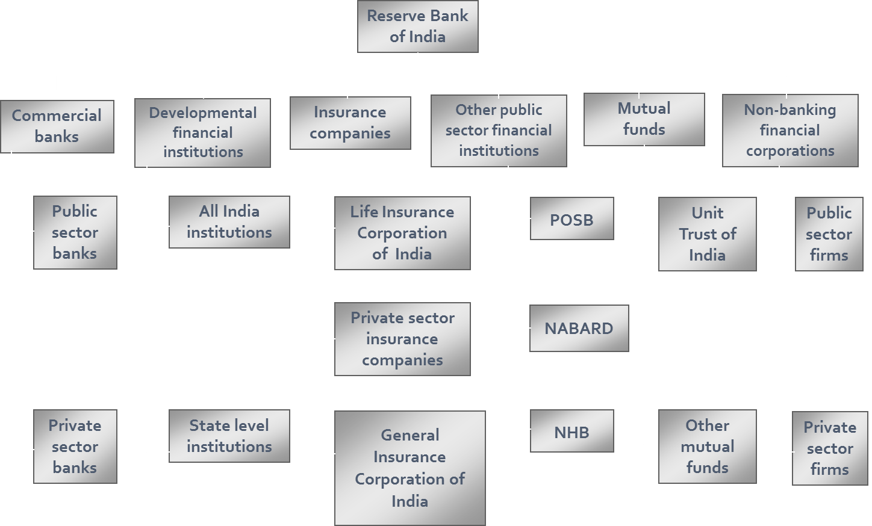
FINANCIAL INTERMEDIARIES

Slide 16
RATIONALE FOR FINANCIAL INTERMEDIARIES
Diversification
Lower Transaction Cost
Economies of Scale
Confidentiality
Signalling

Slide 17
RATIONALE FOR FINANCIAL INTERMEDIARIES
DIVERSIFICATION
The pool of funds mobilised by financial intermediaries is invested in a broadly diversified portfolio of assets (loans, stocks, bonds and so on).
LOWER TRANSACTION COST
The transaction cost in percentage terms decreases as the transaction size increases.
ECONOMIES OF SCALE
Financial institutions enjoy economies of scale
CONFIDENTIALITY
Information shared with financial intermediaries may be kept confidential whereas information disclosed to numerous individual investors is in public domain.
SIGNALLING
Financial intermediaries can pick up and interpret signals and cues better. So they perform a signalling function for the investment community.

Slide 18
REGULATARY INFRASTRUCTURE
RESERVE BANK OF INDIA
SEBI

Slide 19
KEY TRENDS IN THE INDIAN FINANCIAL SYSTEM
Market-determined interest rates and greater volatility of interest rates
Emergence of universal banks
Emphasis on prudential regulation and supervision
Gradual integration with the global financial system
Increase in financial innovation

Slide 20
SUMMING UP
The financial system – consisting of a variety of institutions, markets, and instruments related in a systematic manner – provides the principal means by which savings are transformed into investments.
The financial system provides a payment mechanism, enables the pooling of funds, facilitates the management of uncertainty, generates information for decentralised decision making, and helps in dealing with informational asymmetry.
Financial assets represent claims against the future income and wealth of others. Financial liabilities, the counterparts of financial assets, represent promises to pay some portion of prospective income and wealth to others.

Slide 21
SUMMING UP
Contd…
The important financial assets and liabilities in our economy are money, demand deposit, short-term debt, intermediate-term debt, long-term debt, and equity stock.
A financial market is a market for creation and exchange of financial assets. Financial markets facilitate price discovery, provide liquidity, and reduce the cost of transacting.

